Slide 1
Volcanic Ash Dispersion Modeling
Barbara Stunder
Air Resources Laboratory
ARL Laboratory Review
May 3-5, 2011

Slide 2
From USGS presentation to Geological Society of America (for reference, see notes)
Notes:
From presentation at the Geological Society of America meeting Oct. 2009
“Assessing Volcanic Hazards and Risks to Aviation” by M. Guffanti, J.W. Ewert and T.L. Murray, USGS
Current European proposal to international community is to have a minimum acceptable ash concentration for flight, rather than complete avoidance.

Slide 3
From USGS presentation to Geological Society of America (for reference, see notes)
Notes:
From presentation at the Geological Society of America meeting Oct. 2009
“Assessing Volcanic Hazards and Risks to Aviation” by M. Guffanti, J.W. Ewert and T.L. Murray, USGS

Slide 4
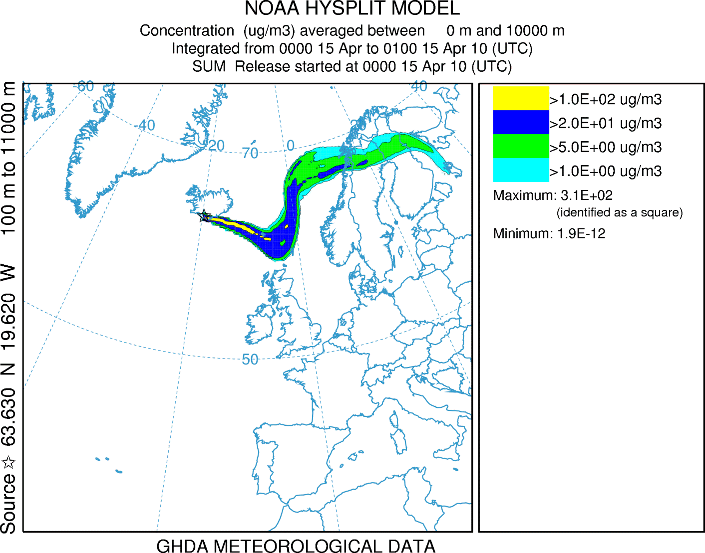
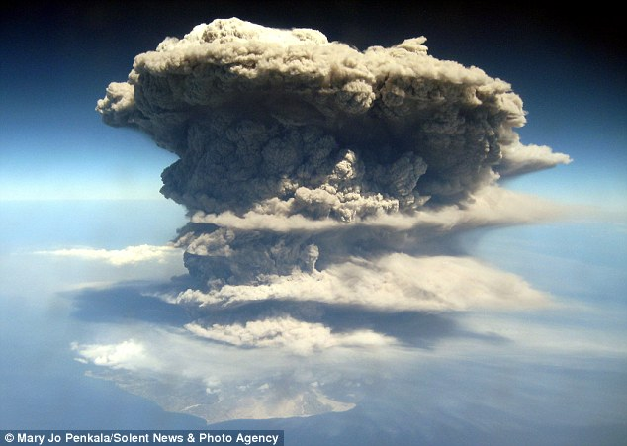
Goal: Improved forecasts for safe aviation
Notes:
Jet engines can fail during a volcanic ash encounter. Airspace in Europe shut down several days last spring.
NOAA is responsible for issuing Warning products for aviation (SIGMETS). International Civil Aviation Organization (ICAO)-designated Volcanic Ash Advisory Centers (2 run by NOAA) have satellite analyses capabilities, run forecast dispersion models, and issue Advisory products to support issuance of SIGMET.
The SIGMET are issued by the ICAO-designated Meteorological Watch Offices – in the NOAA NWS, Honolulu Weather Forecast Office, Alaska Aviation Weather Unit, and the Aviation Weather Center.

Slide 5
Approach:
ARL develops improvements based on customer needs,
where customers are U.S. Volcanic Ash Advisory Centers (VAAC) (NWS and NESDIS),
whose customers are the offices which write SIGMET, FAA, and the airlines,
Anchorage, AK, VAAC
(NWS [non-NCEP])
Washington, DC, VAAC
(NESDIS / NWS [NCEP])
Notes:
Our immediate customers are the Washington, DC, and Anchorage, AK, Volcanic Ash Advisory Centers (VAAC), who in turn issue products (advisories) to the Meteorological Watch Offices that write/issue SIGMET (warnings), the airlines and FAA.
The Washington VAAC is jointly operated by NWS National Centers for Environmental Prediction (NCEP) and NESDIS Office of Satellite Data Processing and Distribution.
The Anchorage VAAC is within the NWS.
For example, NOAA Volcanic Ash Advisory Group was set up to improve the U.S. volcanic ash products and services following last spring’s Iceland eruption.

Slide 6
Model output depends on source term
Height
Volcano latitude, longitude, … plus eruption start and end time

Slide 7
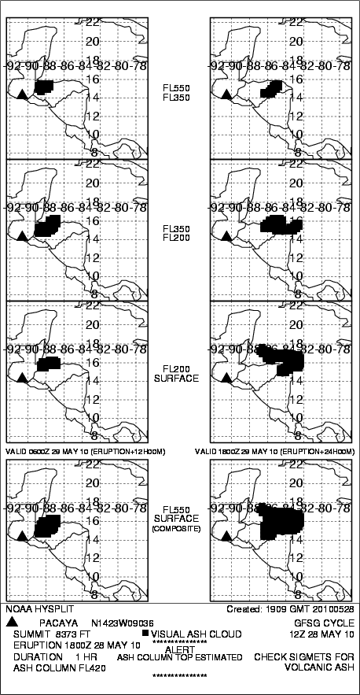
Model output depends on source term
unit source
NWS HYSPLIT
model output for Pacaya volcano,
Guatemala, Central America
Notes:
Current international standards require forecasts of ash, with no threshold concentrations defined. Hence the NCEP dispersion model, HYSPLIT, uses a unit mass source, and defines the edge based on a qualitative correlation with satellite analyses of a handful of historical eruptions.
The NWS-issued model output graphic is an 8-panel chart. The example is from an eruption in Guatemala, Central America.

Slide 8
Left-hand column, valid 12-h after eruption start
NWS HYSPLIT Model output for Pacaya volcano,
Guatemala, Central America
Notes:
Valid time label between the bottom two plots in each column.

Slide 9
Left-hand column, valid 12-h after eruption start
Right-hand column, valid 24-h after eruption start
NWS HYSPLIT Model output for Pacaya volcano,
Guatemala, Central America

Slide 10
NWS HYSPLIT Model output for Pacaya volcano,
Guatemala, Central America

Slide 11
FL550 ≈55,000 ft
Notes:
Plots at the bottom are for the layer-composite from the surface to ~55,000 ft.

Slide 12
NWS HYSPLIT Model output for Pacaya volcano,
Guatemala, Central America

Slide 13
3 layers
Notes:
The three upper plots in each column show the ash footprint in three separate atmospheric layers.
~35,000 – 50,000 ft
~20,000 – 35,000 ft
Surface - ~20,000 ft

Slide 14
Model output depends on source term
Model output for Pacaya volcano,
Guatemala, Central America
Notes:
Hence, the unit source gives this output.

Slide 15
Approach:
ARL develops improvements based on customer needs ….
… and with partners, is developing improvements to the
HYSPLIT volcanic ash source term, including methods to account for its uncertainty
Notes:
The source term is key to quantitative dispersion model output.

Slide 16
Source term approaches . . . initialization at the volcano
(small) (medium) (large)
(1)
“Preliminary Spreadsheet of Eruption Source Parameters for Volcanoes of the World”
(3)
(2)
H (km) = 0.41 M (kg/s) ^{0.222}
& mass fraction of fines
Ensemble
Notes:
Source term approaches – starting at volcano
Eruption Source Parameters (ESP) – USGS classified ~1500 volcanoes worldwide into 2 main eruption types, each with a few subcategories representing relative size of eruption (small/medium/large), with each type/subcategory being composed specifically of an eruption height, duration, mass (volume), and fraction of fine ash. Shown is example output from the small/medium/large subcategories for a hypothetical eruption of Fuego, Guatemala, within the Washington, DC, Volcanic Ash Advisory Center’s area of responsibility. This type of output for hypothetical eruptions of recently active volcanoes or for volcanoes that may erupt are available daily on ARL’s website for user evaluation. [http://ready.arl.noaa.gov/ready2-bin/ashhypo.pl] . USGS has been a collaborator and a link to other volcanologists. Reference: Mastin, L.G., Guffanti, M., Ewert, J.E., and Spiegel, J., 2009, Preliminary spreadsheet of eruption source parameters for volcanoes of the world: U.S. Geological Survey Open-File Report 2009-1133, v. 1.2, 25 p.
Equation: From volcanologists, this equation relates the eruption column top to the eruption mass flow rate, but only for umbrella type (large, explosive) eruptions. This equation is not for “weak” (bent-over) plumes. Further the USGS has recommended an equation describing the initial vertical distribution of ash that is more accurate than our default uniform distribution. However there are qualifiers for both these equations. In the first, the mass flow rate is of ALL the ejecta from the volcano, but we are interested only in the fraction of fine ash that remains aloft. In the latter, a constant in the equation is not well defined. ARL plans to make this source term information available as an option for the VAAC.
Ensemble: An ensemble can be generated readily using source term parameters that span the source term uncertainty. Shown is an example showing the number of members with concentrations greater than zero.

Slide 17
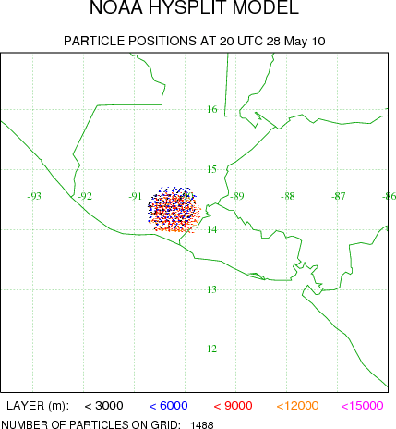
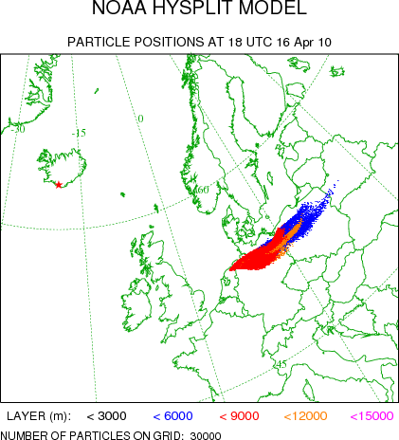
Source term approaches (cont) . . . initialization with downwind observations
(4)
OBS VA DTG: 28/1845Z
OBS VA CLD: SFC/FL420 N1438 W09008 - N1427 W09001 - N1411 W09010 - N1413 W09034 - N1419 W09038 - N1428 W09044 - N1437 W09038 - N1438 W09008
(location information only)
(5)
(location and mass loading)
Notes:
HYSPLIT initialization - downwind source term, rather than at volcano
(4) Extract from a Volcanic Ash Advisory giving the description of the observed ash cloud (series of latitudes-longitudes defining a polygon). Future work is to initialize HYSPLIT with this information.
(5) NESDIS satellite observation of Eyjafjallajokull, Iceland, ash plume valid April 16, 2010, 1830z. (image from http://www.ssec.wisc.edu/media/may2010.html). Future work to initialize HYSPLIT with satellite quantitative data (height, effective particle size, mass loading).

Slide 18
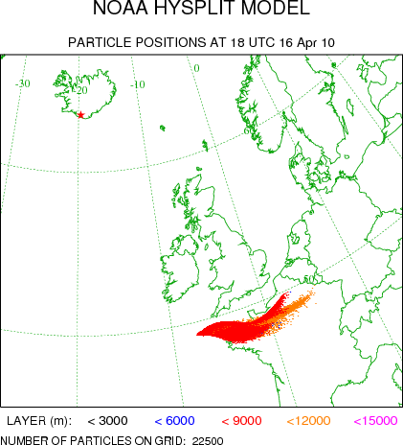
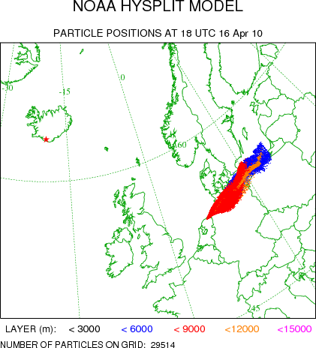
Accomplishment:
ARL developed interim solution for HYSPLIT initialization and delivered it to NWS for operational implementation
(6)
+ =
(adjusted model output becomes initialization for forecast)
(observed location)
+ =
(model output)
Notes:
HYSPLIT initialization – downwind rather than at volcano
(6) In this solution, the forecaster forces an adjustment of the model output to more closely agree with satellite observations. Then this adjusted position is the initialization for the forecast update.

Slide 19
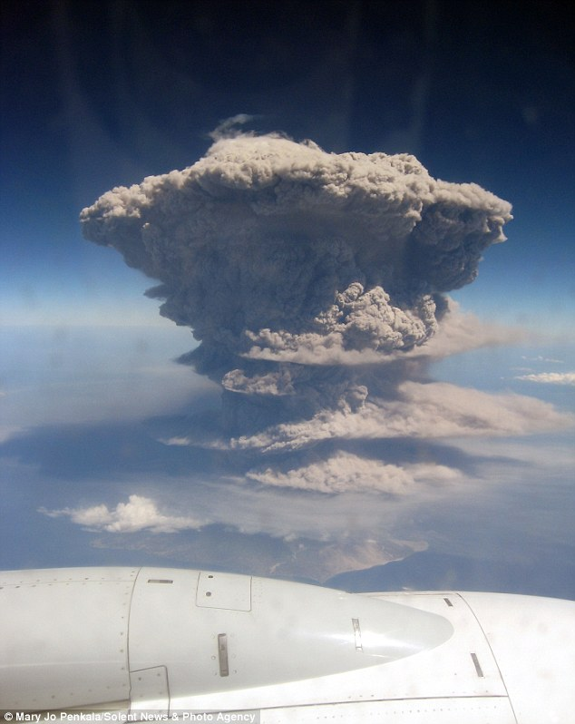
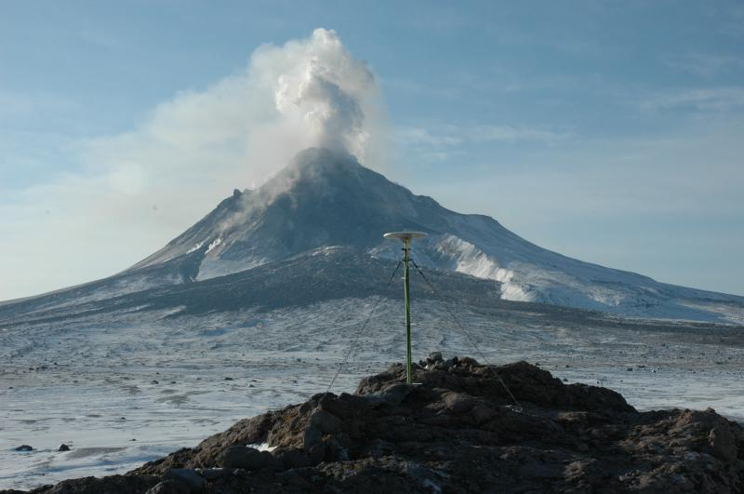
Need a verification database:
source term
observations
analysis meteorology
statistics program
=
historically active volcano
Notes:
A good verification database is needed to evaluate the accuracy of volcanic ash dispersion forecasts and to ensure that model changes are improvements.
Little evaluation has been done on the volcanic ash dispersion model. In-situ ash measurements are virtually unheard of. Instead, satellite images showing an ash footprint have been used for evaluation. Eruptions need to span the gamut – over the spatial extent of the US VAAC regions, large and small eruptions, short and long eruption durations, etc. The red dots show the locations of some of the volcanoes that have erupted in the recent past in and near the US Volcanic Ash Advisory Center’s areas of responsibility. We want this reference database to be used as much as possible as the DATEM (Data Archives of Tracer Experiments and Meteorology) database is used. [http://www.arl.noaa.gov/DATEM.php]
Large eruption - Per bottom of graphic – Mary Jo Penkala, Solent News & Photo Agency (MyDocs\MyPics)
Small eruption - http://www.avo.alaska.edu/image.php?id=8646, Global Positioning System station at Burr Point. Picture Date: March 10, 2006 10:30:00, Image Creator: McGimsey, Game; Image courtesy of AVO/USGS. Please cite the photographer and the Alaska Volcano Observatory / U.S. Geological Survey when using this image.

Slide 20
Partners:
NWS/HQ
ARL
NWS/NCEP
NESDIS
NWS/AR
NWS/AWC
NESDIS
Notes:
ARL has partnered heavily with the NWS and NESDIS. ARL has represented the NOAA VAWG Science Team via several telecons with the head of the NWS, the NOAA Volcanic Ash Working Group Chair (at AWC), the NOAA VAWG Services Team Lead (at NWS/AR), and an NCEP representative.
AR = Alaska Region
AWC = Aviation Weather Center
NCEP = National Centers for Environmental Prediction
(map from weather.gov)

Slide 21
Partners (cont):
Notes:
US Geological Survey
Federal Aviation Administration
Air Force Weather Agency
Air Force Research Laboratory
University of Alaska – Fairbanks, Geophysical Institute
Environment Canada (Volcanic Ash Advisory Center)
And other international partners via ICAO and WMO

Slide 22
Indicators of success:
HYSPLIT volcanic ash model output is issued by the NWS
eruptions occur frequently, most are small;
about 3% of text Advisories issued have an associated HYSPLIT product issued (~50 HYSPLIT forecasts/year)
Publications
Weather and Forecasting, Journal of Volcanology and Geothermal Research
Weather Services International (WSI) uses HYSPLIT products
WSI is one of NWS’s private industry partners
HYSPLIT installed at
Air Force Weather Agency
Buenos Aires, Argentina, Volcanic Ash Advisory Center
Bureau of Meteorology, Australia

Slide 23
Future directions for improving volcanic ash dispersion forecasts
improved HYSPLIT initialization
with observations as given in Volcanic Ash Advisory
with satellite-derived microphysics
create model evaluation database
data assimilation

Slide 24
The end
“In Iceland, they were used to volcanic activity, … some 200 km west of … Reykjavik,… spewing red hot lava, dust, ash … into the air. For eight months the eruptions continued…”
“In the town of Selbourne, in Hampshire, Gilbert White wrote:
The summer of 1783 was an amazing and portentous one, … the peculiar haze or smokey fog, that prevailed for many weeks, … was a most extraordinary appearance… . The sun, at noon, looked as black as a clouded moon…”
from Halford, P., 2004: Storm Warning – The Origins of the Weather Forecast, Sulton Publishing Ltd., 295 pp.
Notes:
Some things never change.
Image source: http://en.keilir.net/static/files/Aviation/PDF/Eyjafjallajokull_and_Aviation_Conference_Program.pdf

